Slide 1

Maestosa
Milkline Rotary
Proactive and Operator

Slide 2
Maestosa Overview
The most advanced technology
  Milkline Miking technology
  R&R Rotary technology
  The Product
  The Project

Slide 3
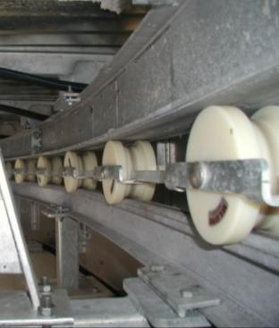
Platform Rotation - Roller and Chassis System
Roller and double I-beam design
The Heavy Duty Concept
!
Double I-Beam: Hot dipped galvanized
Rail road track and drive ring plate
Separate thick drive ring plate

Slide 4
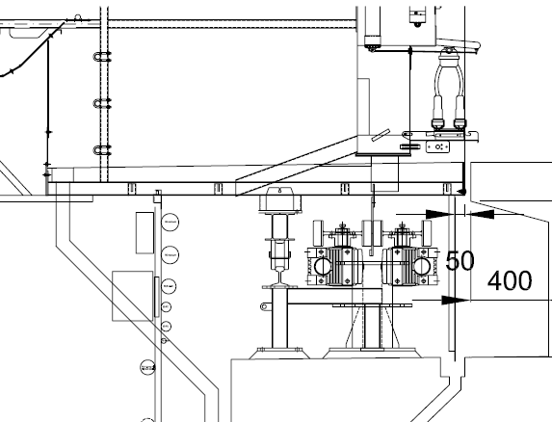
Double I-Beam Concept

Slide 5
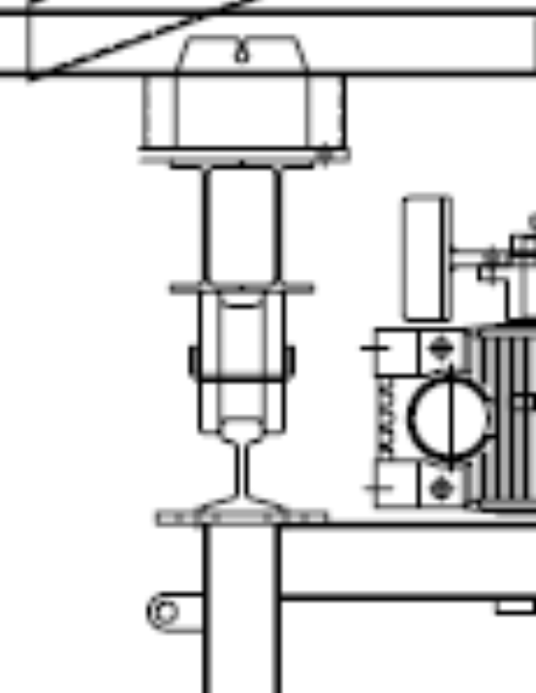
Double I-Beam Concept
Platform Section
Platform
Concrete
Double
I-Beam
Platform Weight Forces
Roller
Tapered Platform Diameter
Rail-Beam
Post

Slide 6
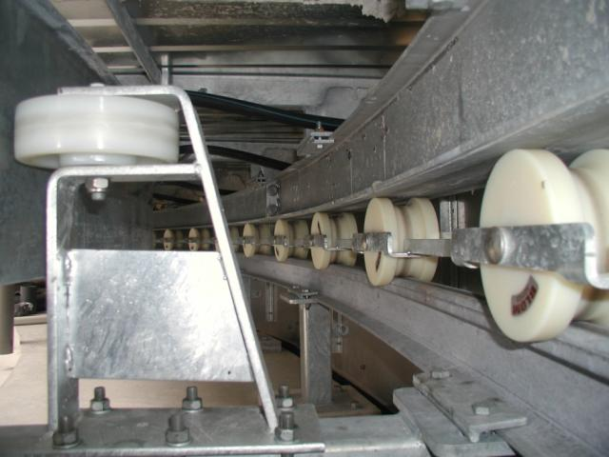
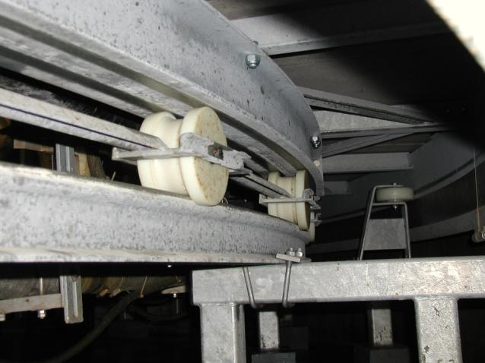
Roller System
External Parallel Rotary
Internal HB Rotary

Slide 7
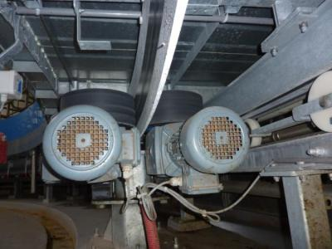
Platform Drive System
Heavy Duty Concept:
Strong and reliable design
Ramping and speed adjustment by VFD
No side loading on the drive plate.
Redundant drive system
1,1 kW Motors

Slide 8
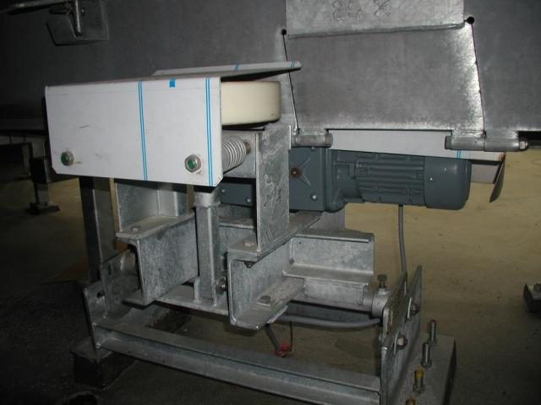
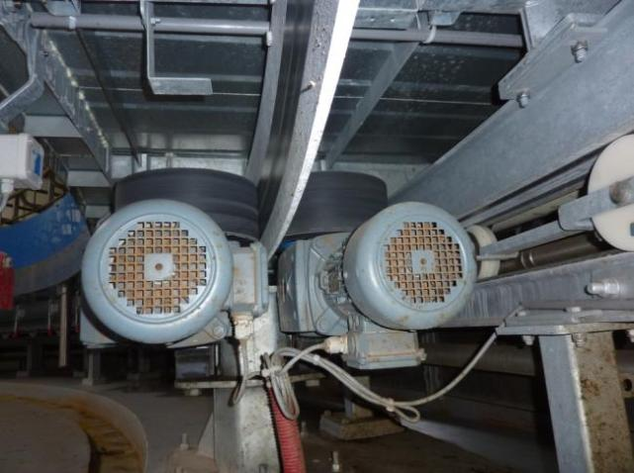
Electric Drive System
Single Drive
Double Drive

Slide 9
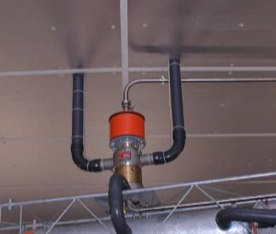
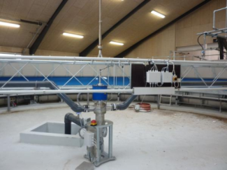
Rotary Swivels
HD Concept:
Rotary central glands are designed and produced for this specific application
Two types:
Model II – Internal Rotaries
  Vacuum
  Milk
  Power Supply and Data
Model V – External Rotaries
  Vacuum
  Milk
  Air or water
  Power Supply and Data

Slide 10
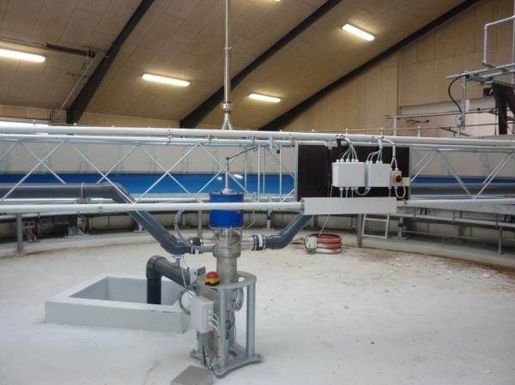

Rotary Swivels
Model V - Parallel Rotaries
Model II – HerringBone Rotaries

Slide 11
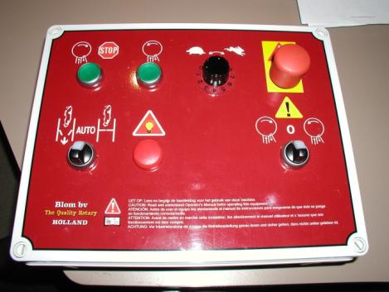
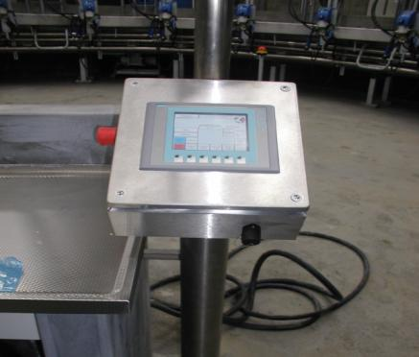
Rotary Control
Standard Control: Large push buttons. Clear and simple
Advanced Control: Touch Screen with almost unlimited options
  Ramping and speed adjustment by VFD
  Control cabinet with PLC and frequency controller
  Control panel on Stainless Steel post
  Emergency mode

Slide 12
Standard Rotary Control
Main Features:
  Rotation speed control
  Safety system
  Emergency switches
  …

Slide 13
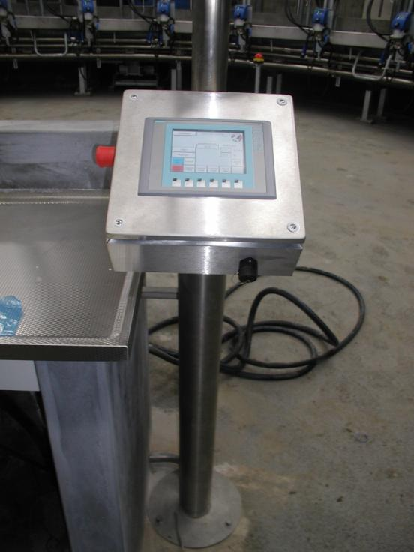
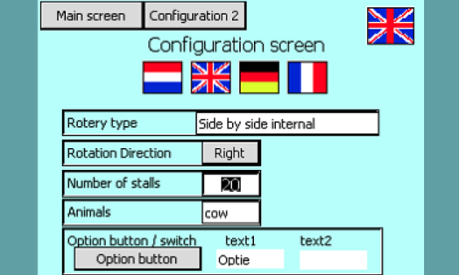
Advanced Rotary Control
Features as Standard &…
  Setup
  Monitoring
  Diagnostics
  …

Slide 14
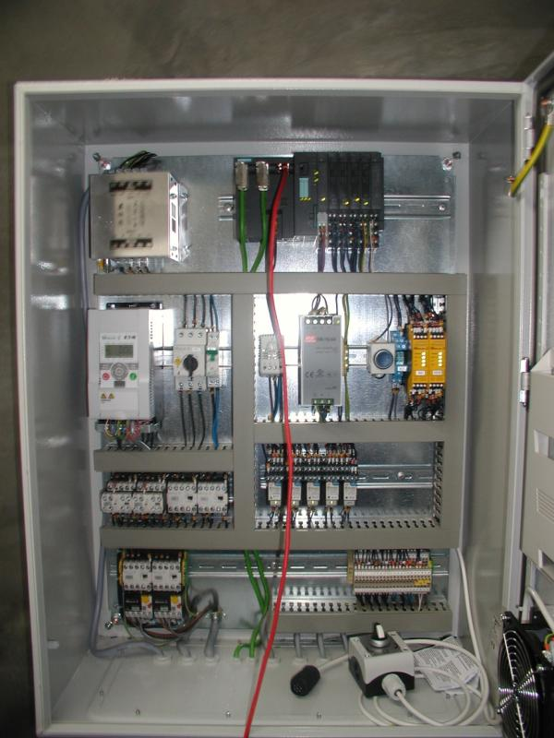
Emergency Mode
The system is provided with Emergency Switch.
In case of Emergency, the switch must be connected directly to the Rotary Control box.
This will exclude all automation and control devices and allow to go forward and backwards 1 speed.

Slide 15
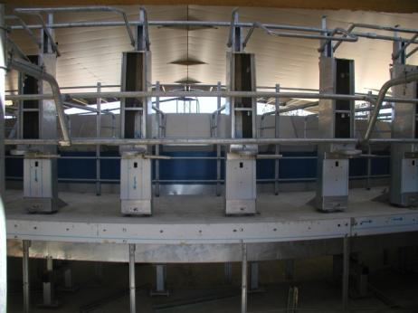
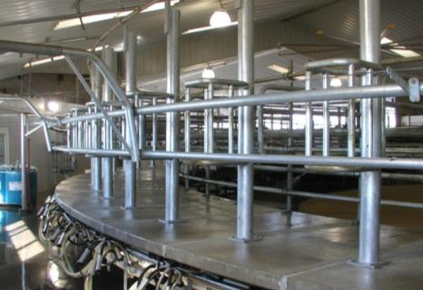
  Milkline External Rotary: 2 Models Available
Milkline ProActive Rotary
  Cabinet Bails , Full Automation possible
  Milking Equipment installed at the inside (Subway system)
  Skirting.
  Deck with gutter , keep inside clean and dry
Milkline Operator Rotary
  Open bail frames
  Milking Equipment installed at the outside
  No skirting
  Short deck no gutters

Slide 16
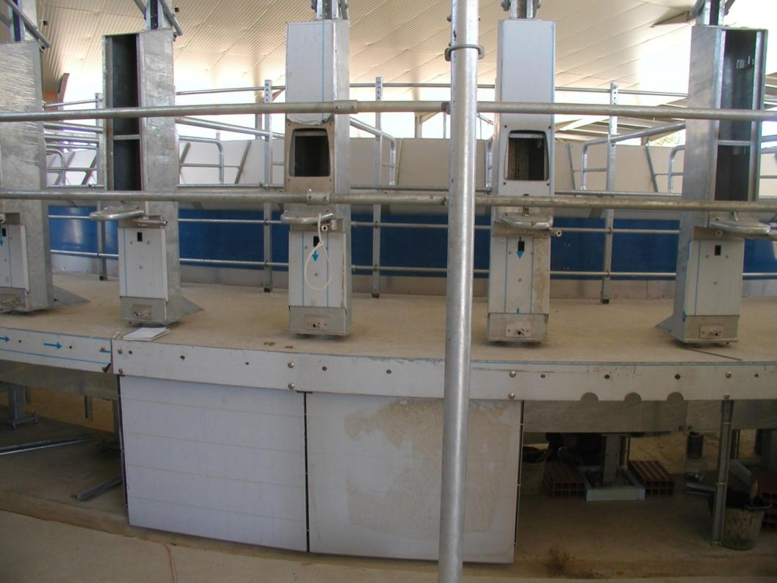
ProActive - Installation (the skirt)

Slide 17
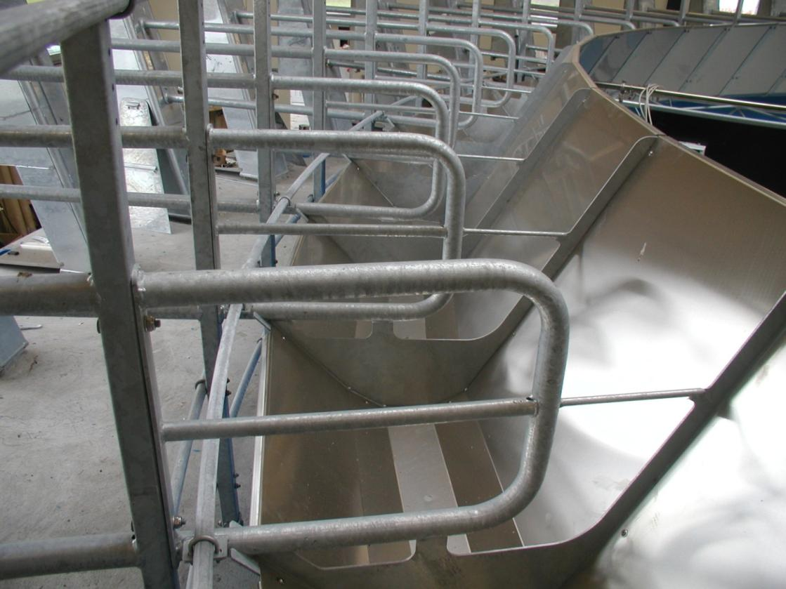
ProActive: Bail with Feeding Manger

Slide 18
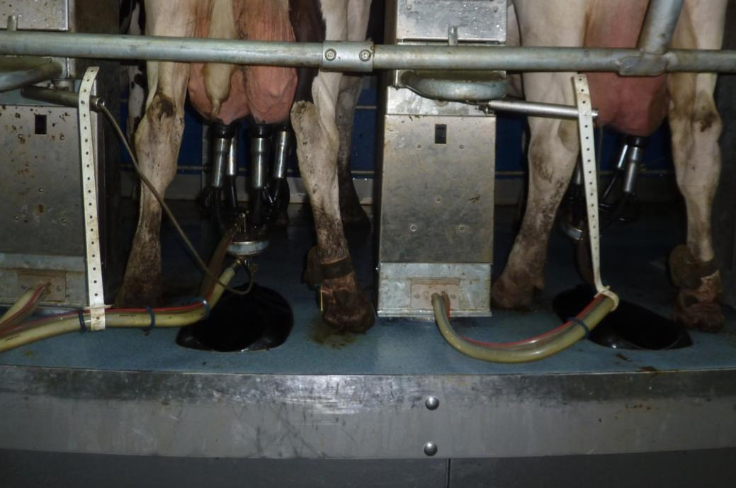
ProActive: Tube Alignement Arm

Slide 19
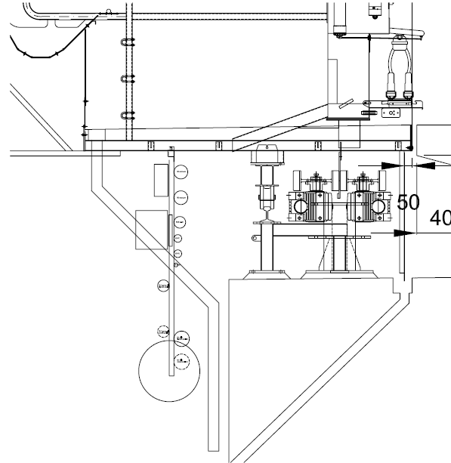
ProActive: Platform Cleaning
Clean Platform and clean Internal Pit
Platform Gutter
Drain Tube
Internal Pit Gutter

Slide 20
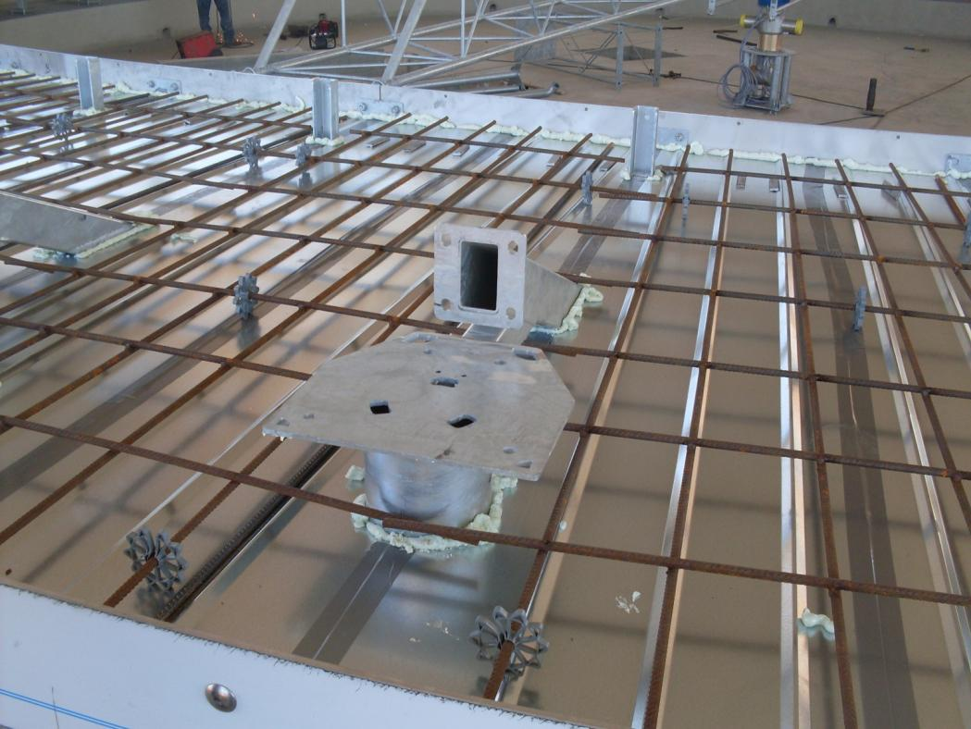
ProActive: Structure Before Pouring

Slide 21
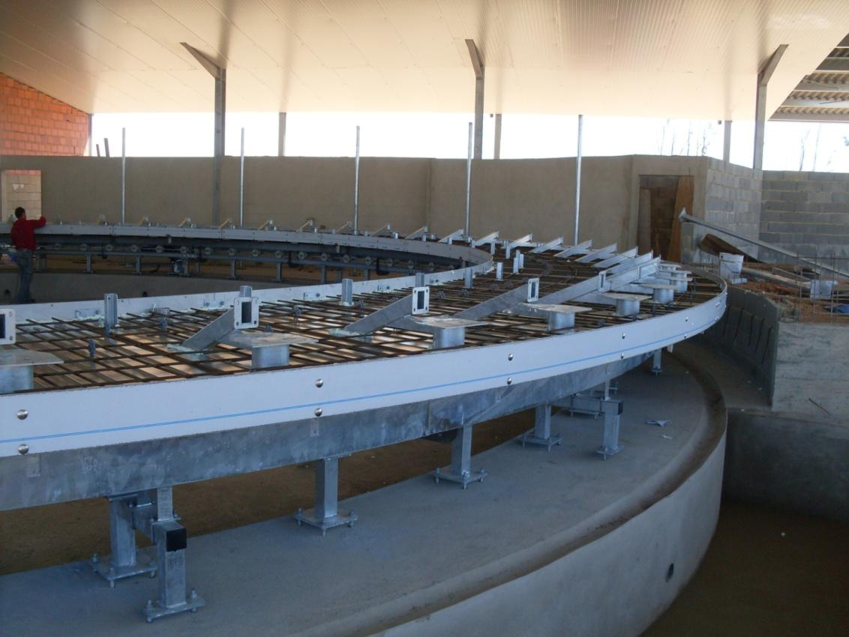
ProActive: Structure Before Pouring

Slide 22
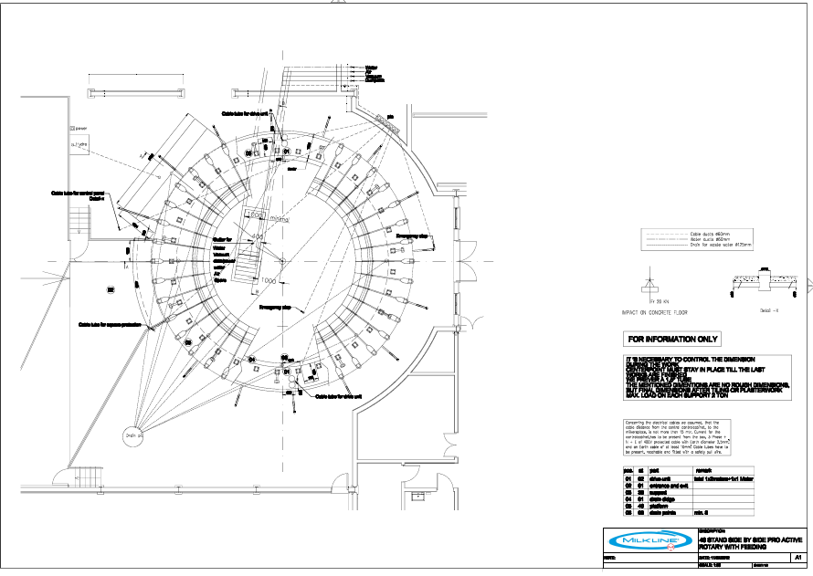
ProActive: Design Projects

Slide 23
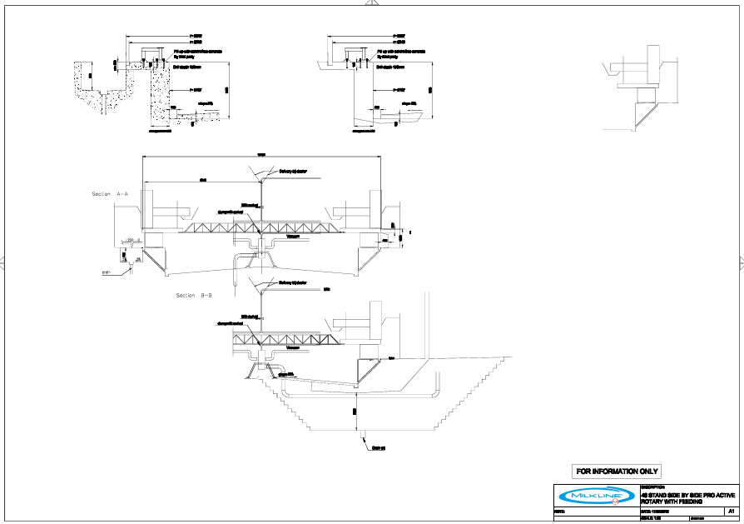
Proactive: Design Projects

Slide 24
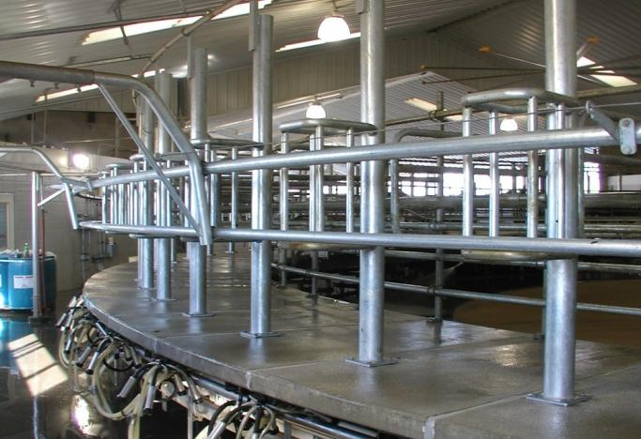
Milkline Operator Rotary
  Milking Equipment installed at the outside
  Short deck no gutters
  Open bail frames
  No skirting

Slide 25
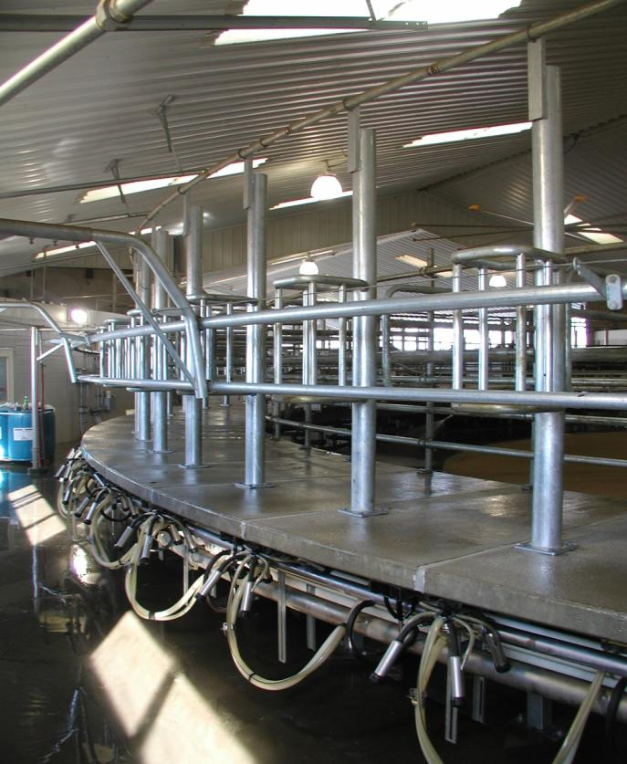
Maestosa: Operator Model (Short Deck)

Slide 26
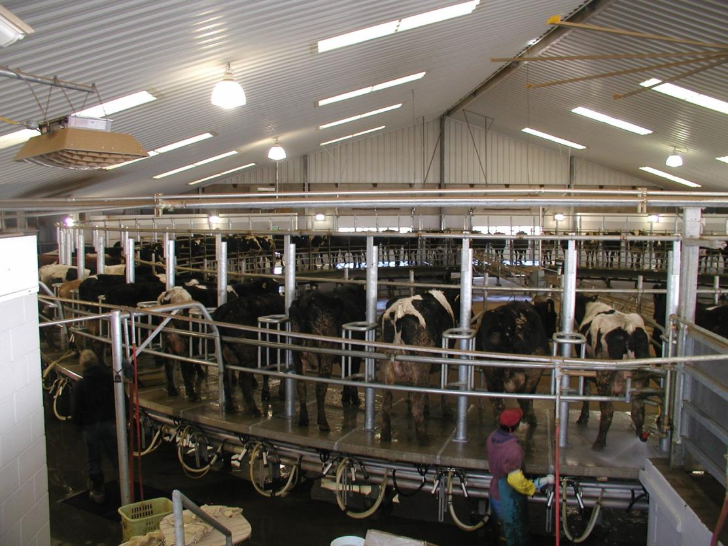
Operator Model

Slide 27
  Side by Side External Rotary
N° of Places | Drive Units | N° of Motors | Diameter (m)
24 | 1 | 2 | 7,64
28 | 1 | 2 | 8,92
32 | 1 | 2 | 10,19
36 | 1 | 2 | 11,46
40 | 2 | 3 | 12,74
44 | 2 | 3 | 14,01
50 | 2 | 3 | 15,92
60 | 2 | 4 | 19,10
72 | 3 | 6 | 22,92
80 | 3 | 6 | 25,47

Slide 28
Maestosa: Automation Range
Proactive
  ED200
  P4C
Operator
  MPD New
  Milpro Red
Preliminary Info

Slide 29
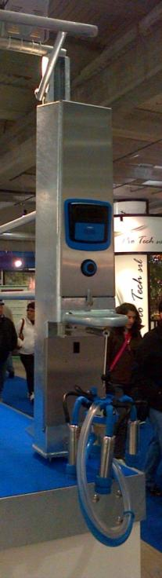
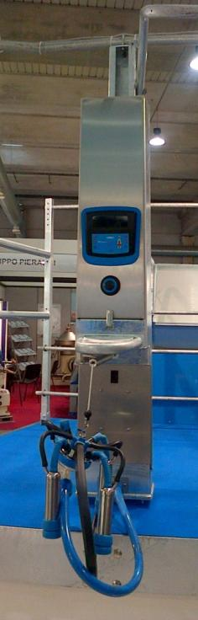
Maestosa ProActive: ED200 and P4C

Slide 30
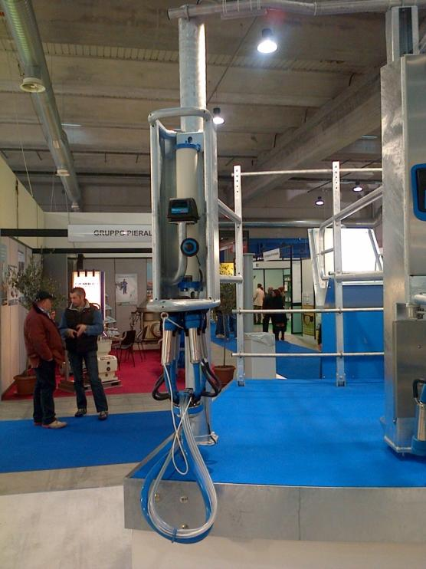
Maestosa Operator: Milpro RED

Slide 31
Milkline Herringbone Rotary

Slide 32
  Maestosa - Herringbone Rotary
N° of Places | N° of Motors | Diameter (m)
12 | 1 | 7,53
14 | 1 | 8,26
16 | 1 | 8,98
18 | 1 | 9,69
20 | 1 | 10,40
22 | 1 | 11,80
24 | 2 | 11,80
26 | 2 | 12,50
28 | 2 | 13,20
30 | 2 | 13,90
32 | 2 | 14,00
36 | 2 | 16,00
40 | 2 | 17,40

Slide 33
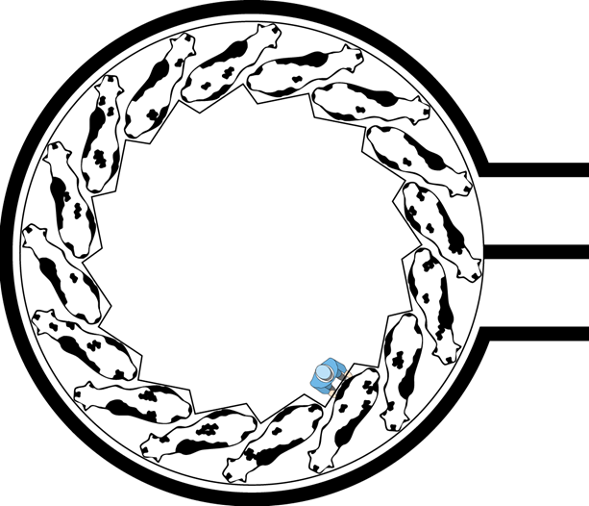
  Herringbone Milking Rotary
Herringbone without feeding
Stall structure with no moving parts
Unique Zig Zag for best udder access
Herringbone with feeding
Stalls with feeding mangers
Feed-mangers with locking device
Unique Zig Zag for best udder access

Slide 34
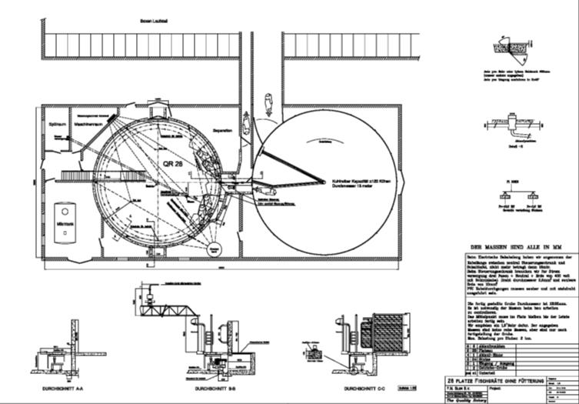

Slide 35
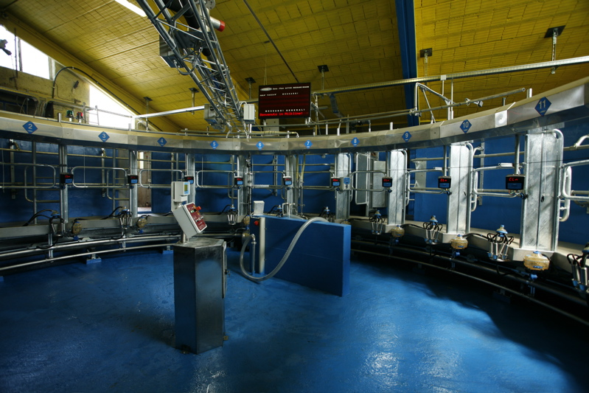
Milkline Herringbone Milking Rotary

Slide 36
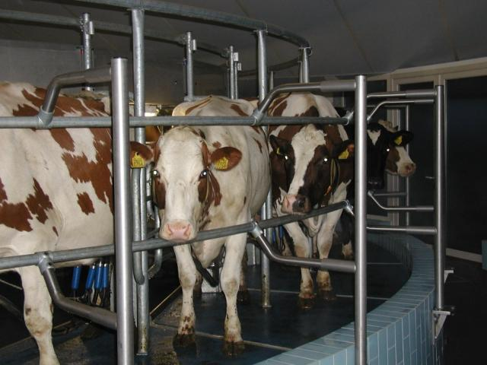
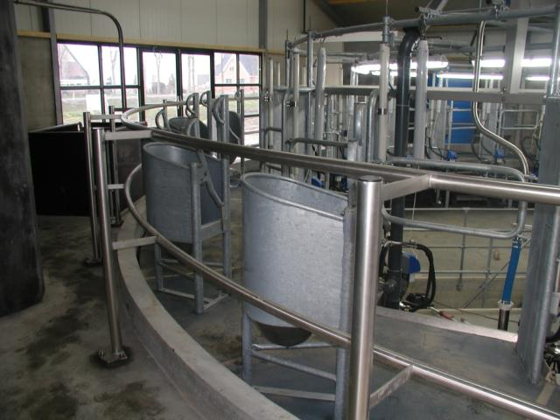
Herringbone Milking Rotary
W/O IPF Feeding
With Feeding

Slide 37
Rotary Types and related products
  Side by Side External Rotary
  Herringbone Rotary
  Crowdgate Rectangular and Circulair in Heavy Duty Types

Slide 38
Thank you

